Slide 1
Development of KS and Construction Field Test·Certification System
Kim, Tae-sang
Korea Conformity Laboratories

Slide 2
Table of content
Introduction
Korean Standards (KS)
Technical Regulation
Conclusion

Slide 3
Introduction
Definition of Terms
Standards : Regulations approved by a standardization body through a stakeholder consensus process for repeatable and commonly applicable targets
Standardization : Organizational behavior that sets standards and utilizes them
Conformity Assessment : Activities to prove whether the evaluation target, such as products, procedures, systems, personnel, and institutions, conforms to the specified standards and requirements by the authorized body
Test : Identification of characteristics according to specified requirements for a product process or service.
Inspection: Conducting investigations into product design, product, process or installation and confirming compliance with specified requirements
Certification : It guarantees that the prescribed requirements for products, systems, qualifications, services, etc. are met, and is classified into product certification, service certification, system certification, qualification (personal) certification, and is used in various terms such as certification, type approval, verification, designation, permission, etc.
(National Standard Certification Integrated Information System, 2022)

Slide 4
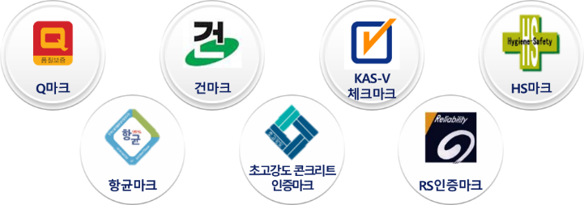



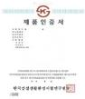
Introduction
Definition of Terms
Certification system : The certification system refers to the act of directly performing an evaluation by a qualified person or proving it based on the evaluation results of a third party to determine whether the evaluation target meets the evaluation criteria applied thereto. ( ISO/IEC 17000, KS A ISO/IEC Guide 2 )
It is divided into a legal certification system and a private certification system, and the legal certification system is again divided into compulsory certification and voluntary certification depending on the presence or absence of coercion. In addition, the certification system implemented by each department is operated under various names according to the characteristics of the certification target, such as certification, type approval, verification, type verification and type registration
Technical Regulation : Technical standards define "standard adopted by government or organization or legally binding" (KS A 0014), or "including applicable administrative regulations, the characteristics of the product or related processes and production methods, and compliance may include or deal with terms, symbols, packaging, marks, or product attachment requirements. (WTO/TBT)
Legal certification
Private certification
Compulsory certification
Voluntary certification
(National Standard Certification Integrated Information System, 2022)

Slide 5

Introduction
Law and Standards
Paragraph 2, Article 127 of the Constitution of the Republic of Korea “The State shall establish a system of national standards!”
Constitution
Framework Act
on National Standards
Define national standards, establish a framework act, align national standards with international standards, and prescribe obligations for utilizing national standards
Introduce a pan-governmental national standard operating system to relieve the burden (Duplicate certifications) on companies
➔ Harmonize the government ministries’ technical(certification)standards with
national standards(KS), and integrate some similar legal certification systems into KS certification
Laws in regard to Standards, Certifications
Operate a safety certification system to secure product safety for consumers
Measurement standards
A physical scale, measuring instrument, reference material, measuring method and measuring system used as the standards for defining, expressing, preserving and practically realizing a unit of measurement of a quantity in the shape of an object or the value of a specific quantity in the industrial, scientific and technical fields
Reference standards
Things that have been officially approved through scientific analysis and evaluation of the accuracy and reliability of measured data and information
National Standards
Codified standards
Written scientific and technical criteria, specifications and guidelines which are applied voluntarily in order to raise the overall comprehensibility, efficiency, economic feasibility, etc. in every area of the nation’s communities
Technical regulations
Standards that are compulsorily applied to products and services to protect human health, safety and environment, and prevent deceptive acts against consumers
(Electrics, Electronics and Information Standard, KATS, bae, 2021)

Slide 6
Introduction
Classification of standards according to scope
International standards
ISO(International Organization for Standardization)
IEC(INTERNATIONAL ELECTROTECHNICAL COMMISSION)
Local standards
CEN((Eurozpean Committee for Standardization)
PASC (Pacific Area Standards Congress)
CENELEC(European Committee for Electrotechnical Standardization)
National standards
KS(Korea/ATS), ANSI(USA/ANSI), BS(UK/BSI), CAN(Canada/SCC),
DIN(Germany/DIN), GOST(Russia/GOST-R), GB(China/CSBTS),
JIS(Japan/JIST), AS(Australia/SAI),
Group standards
ASTM( American Society for Testing and Materials),
ACI(American Concrete Institute), UL(Underwriters Laboratories Inc),
VDE(Verband Deutscher Elektrotrchniker e.v)
In-house standards
Ford Motor Company standards, Hyundai standards, Samsung standards
(Korean Standards Association., 2022)

Slide 7
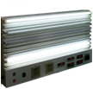

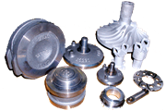




Introduction
Role of standards
The role of standards: Strengthen industrial competitiveness by enhancing quality,
increasing compatibility, simplifying unification, and delivering information
Traditional role of standards
Enhance quality
Increase compatibility
Simplify unification
Deliver information
Fluorescent lamp(>8,000hr)
Transportation card
Part unification
Public information illustration
Expanded role as social norm:
* Finance, disaster management, protection of the socially alienated, etc.
* Social responsibility(ISO 26000), quality management system(ISO 9000), environment management system(ISO 14000), security(ISO 27000), etc.
The role of standards is emphasized in the Fourth Industrial Revolution Era:
* Secure interoperability between systems
* Driving force for technological innovation
* Accelerate convergence between products; between product and service
(Electrics, Electronics and Information Standard, KATS, bae, 2021)

Slide 8

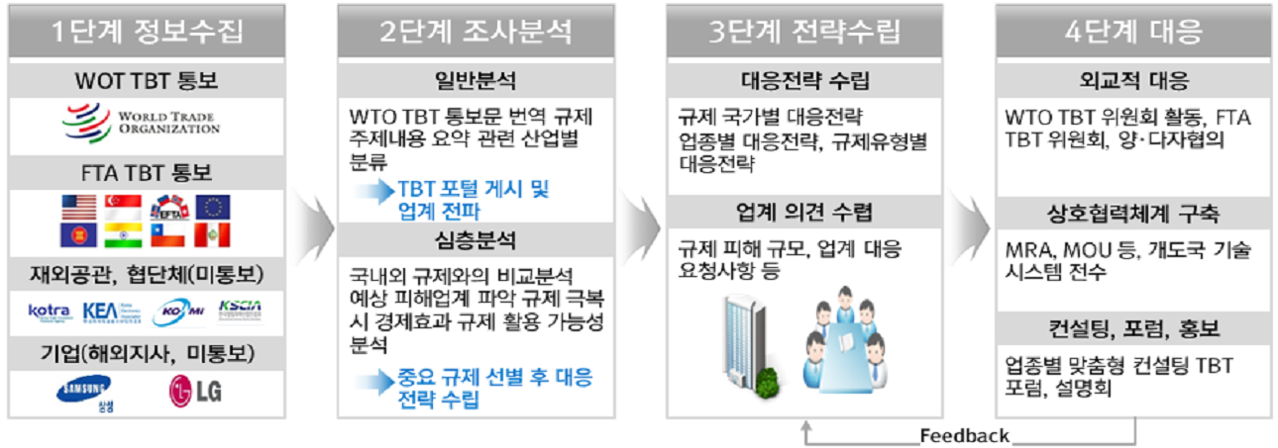

Introduction
Standards within World Trade
Standards became a yardstick for judgement on trade barriers after the conclusion of WTO TBT Agreement(’95)
“If an international standard exists, enacting an additional technical standard is prohibited”
80% of world trade is transacted under the influence of standards(OECD, 1999)
Response to Technical Barriers to Trade
Phase 1
Information gathering
Phase 2
Research analysis
Phase 3
Strategy
setup
Phase 4
Response
WTO TBT notice
General analysis
Establish counterstrategy
Diplomatic response
Translate WTO TBT notice; summarize regulations; categorize by relevant industry
Counterstrategy by regulated country Counterstrategy by business type, Counterstrategy by regulation type
WTO TBT committee activities, FTA TBT committee, bilateral/multilateral consultations
FTA TBT notice
TBT portal posting and
dissemination to industry
Collect industry feedback
Build cooperation system
In-depth analysis
Comparative analysis with
domestic/foreign regulations Anticipate the victim industries;
analyze the economic effect from
overcoming regulations and
the possibility of utilizing regulations
Scale of damage by regulation, industry requirements on the response, etc.
Knowledge transfer of technology, system to developing countries through MRA, MOU, etc.
Diplomatic missions, cooperative groups
(unnotice)
Consulting, forum, PR
Companies(overseas branches, unnotice)
Customized consulting TBT forums by industry, briefing sessions
Come up with counterstrategy
after selecting important regulations
Feedback
(Electrics, Electronics and Information Standard, KATS, bae, 2021)

Slide 9
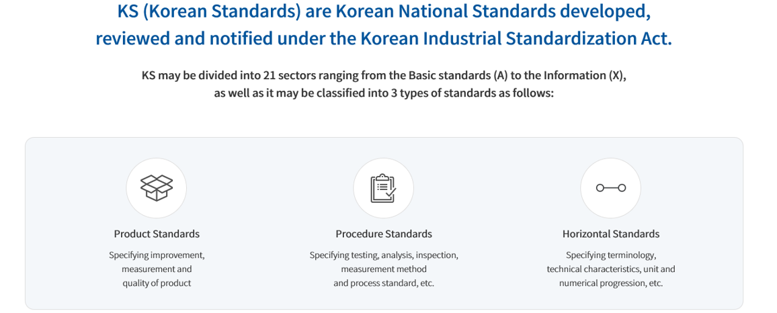
Korean Standards
About KS
Standards for unifying and simplifying the kinds, appearance, quality, producing methods, methods of testing, inspection and measurement of mining and industrial products; and supply methods and procedures of services related to industrial activities
The Industrial Standards Act (Industrial Standardization Act) has been operated since 1962 after its enactment in 1961.
Conduct technical review and deliberation for enactment and amendment of KS by running an Industrial Standard Council comprised of experts from each field
(Korean Standards Association., 2022)

Slide 10
Korean Standards
Classification of KS
Basic Standards(A)
Food(H)
Quality Management (Q)
Mechanical Engineering (B)
Environment (I)
Transportation (R)
Electrical & Electronic Engineering (C)
Organism (J)
Service (S)
Metals (D)
Fiber (K)
Logistics (T)
Mine (E)
Ceramics (L)
Shipbuilding (V)
Construction (F)
Chemistry (M)
Aerospace (W)
Necessities (G)
Medical(P)
Information Technology (X)
(Korean Standards Association., 2022)

Slide 11
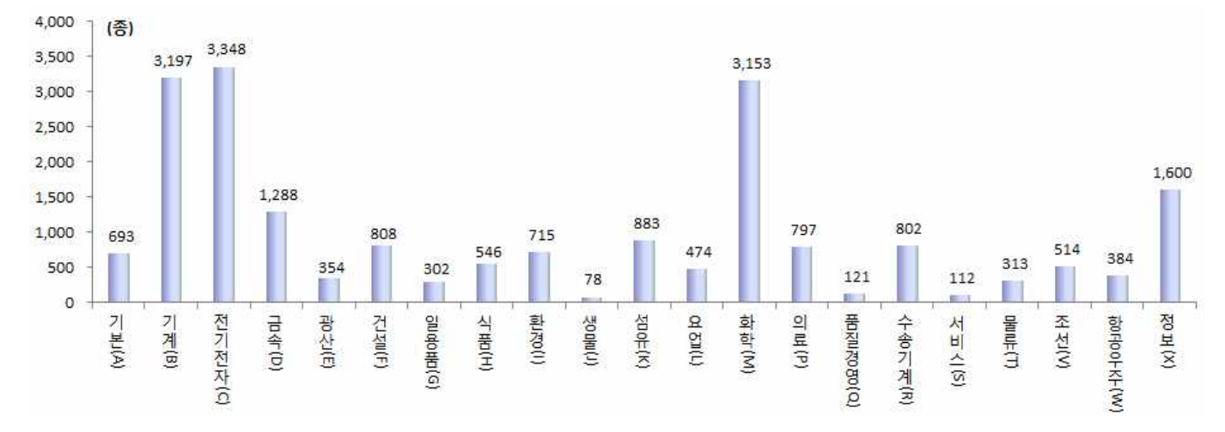
Korean Standards
Organization by field(분야별 구성)
(KATS, Technical standard statistics, 2014)

Slide 12
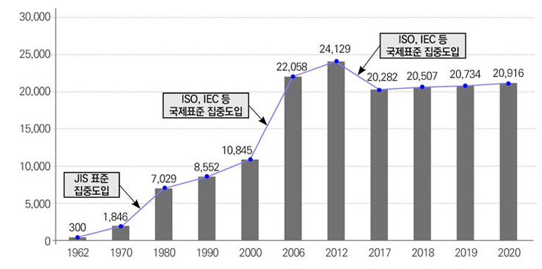
Korean Standards
KS Status by year
Compliance with international standards and transfer to group standards
ISO, IEC, etc. International standards intensive introduction
JIS standard
Intensive introduction
(National Technical Standard White paper, 2020)

Slide 13
Korean Standards
History of KS and Korea Agency for Technology Standards
Early industrialization stage
Economic development stage
Advanced country entry stage
Lay the foundation for commercial transaction and science and technology / Enhance quality through export inspections and quality competitions
Join the WTO and OECD / Carry forward harmonization with international standard
Strengthen the response against foreign and domestic technical regulations / Improve a pan-governmental certification system and initiate impact assessment on technical regulations
Introduce foreign standards from Japan and U.S. / Introduce KS certification system and focus on enhancing the quality of industrial products
Enhance consumers awareness for safety / Reinforce the safety management system
60s~70s
80s~90s
After 2000s
After 2010s
Establish a legal metrology system / KS certification system
Establish a conformity assessment policy / Test analysis and technical support
Establish a safety certification system / Strengthen international standardization activities
Improve technical regulation / Operate a pan-governmental KS system
· Manage a legal meter
Measuring Act, 1961
· Guarantee minimal quality
Industrial Standards Act, 1961
Quality Control of industrial
Products Act, 1967
· Manage a legal meter
Measuring Act, 1961
〮 Enhance product quality
〮 Introduce foreign standard
Industrial Standardization Act,
1998
〮 Support small and medium-
sized technical support
〮 Test certification
〮 Guarantee consumer safety
Quality Management and Industrial Products Safety Management Act, 2000
〮 Introduce harmonization with
international standard
Harmonization between national standard and international standard
〮 International Conformity
Assessment System
〮 Introduce a technical regulation
impact assessment
Linkage between technical regulation
and KS
〮 Introduce a pan-government
KS system
〮 Special Act on the Safety of
Children’s Products
(Electrics, Electronics and Information Standard, KATS, bae, 2021)

Slide 14
Korea Standards
Changes in the definition of technology.
~’70s
’80s
’90s
2000s
Definition of technology
Head /
Hand
Head /
Hammer
Head /
Head
Head /
Heart
Key technology
Facility
(Device)
Skill
Human
emotion
Core infrastructure
Civil engineering
infrastructure
Technology
infrastructure
Knowledge
infrastructure
Soft
infrastructure
The textile industry
The assembly industry
IT, S/W, Bio industry
Heavy chemical industry
The Automobile industry
Shipbuilding industry
Cultural industry
Movies
New industry(intelligent)
(Korean Standards Association., 2010)

Slide 15
Korean Standards
Construction field in KS
Development process in the field of Construction Safety Standards
Timing
Main contents
Remarks
1960s
(Introduction)
- Standardization of Civil engineering and architecture Drawing rules
- Standardization of basic construction materials such as bricks, boundary blocks, and ready-mix concrete
1965 year,
89 type
1970s
(Development)
- Standardization of test methods and terms, such as the wear test method of building materials, etc. - Standardization of basic interior and exterior materials such as roof tiles and windows.
1970 year,
184 type
1980s
(Growth)
Standardization to improve the quality of construction materials such as various residential units and tissue hangers through the Asian Games and the Seoul Olympics.
1980 year,
475 type
The 1990s
(Maturity)
With the construction of 2 million houses, it focuses on standardizing dimensions for the dimensional compatibility of various construction materials and the efficiency of construction.
1990 year,
588 type
2000s
(Transition)
In preparation for the opening of the construction market, it focuses on meeting ISO standards and expanding standardization of fire/structural safety and construction environment sectors.
2000 year,
604 type
(50 years of industrial standardization, 2011)

Slide 16
Korea Standards
Construction field in KS
Status of KS standard retention by category(12,007 type, December 2001)
Construction standards
- KS B : valves, boilers, etc.
- KS C : wires, luminaires, etc.
- KS D : reinforcement, steel, steel pipe, etc.
- KS F : terms, design, materials, construction, etc.
- KS L : cement, tiles, sanitary appliances, etc.
- KS M : PVC flooring, paint, etc.
category
Count
category
Count
category
Count
category
Count
Basic(A)
592
Mine (E)
278
Fiber (K)
580
Transportation (R)
644
Mechanic (B)
1,943
Construction (F)
635
Ceramics (L)
365
Shipbuilding (V)
534
Electric (C)
1,342
Necessities (G)
251
Chemistry (M)
2,248
Aerospace (W)
256
Metals (D)
965
Food(H)
220
Medical(P)
341
Information Technology (X)
813
(Understanding and Utilization of KS, KATS, Kim, 2002)

Slide 17
Korea Standards
Construction field in KS
Classification in detail
Product standard : 861 types
Total : 1,639 type
Electric equipment material 105type
Wire, track supplies 40 luminaires 16 Wiring, electrical equipment 49
Reagent standard : 57 types
Construction standard :
23 types
Waterproof thermal insulation materials 47 type
Other materials 134 type
Reagent 57 type
Construction 23 type
Waterproofing material etc.
Bonding and glue etc.
Reagent/Test equipment 57
Construction standard/ Construction machine 23
Interior and Exterior materials 66 type
Hytgiene management
158 type
Window materials 46 type
Delivery method standard : 698 types
glass etc.
flooring etc.
boiler etc.
Method standard 591 type
Delivery standard 107 type
Steel non-ferrous materials 107 type
Structural materials 107 type
Paint 43 type
Test/Inspection/
Measurement 591
General/Structure/
Design 107
Volt nuts etc.
cement etc.
Base paint etc.
(Understanding and Utilization of KS, KATS, Kim, 2002)

Slide 18
Korea Standards
KS Enactment Procedure
Korean Industrial Standards (KS)
① Accept application
▶ Apply as interested party
▶ COSD by each field
▶ Self development by government
(Service, R&D, etc.)
Standards for unifying and simplifying the kinds, appearance, quality, producing methods, methods of testing, inspection and measurement of mining and industrial products; and supply methods and procedures of services related to industrial activities
The Industrial Standards Act (Industrial Standardization Act) has been operated since 1962 after its enactment in 1961.
Comprised of major classifications schemes from basic category(A) to information category(X)
Conduct technical review and deliberation for enactment and amendment of KS by running an Industrial Standard Council comprised of experts from each field
② Expert committee (Technical review)
③ Preliminary announcement
Announcement for enactment,
amendment or abolition
: 60 days
(30 days for minor affairs)
④ Technical Council (Technical deliberation)
⑤ Standards meeting
(Deliberate redundancy, format consistency)
⑥ Final announcement
※ COSD(Co-operating Organization for Standards Development)
(Electrics, Electronics and Information Standard, KATS, bae, 2021)

Slide 19
Technical Regulation
Use of KS For technical regulation
Using 2529 technical regulations from 28ministries
Law
Department
Building Act.
Construction Technology Management Act.
Facilities Safety Management Act. etc.
Ministry of Land, Infrastructure and Transport
Framework ACT on firefighting services
Ministry of Interior and Safety
Enforcement Decree of the Noise and Vibration Control Act.
Ministry of Environment
Occupational Safe and Health Act.
Ministry of Employment and Labor
KS itselft
KS for legal citations
Voluntary standards
Compulsory standards

Slide 20
Technical Regulation
Status of technical regulation by ministries(2022. 2.)
Department
Count
1. Ministry of Land, Infrastructure and Transport
223
2. Ministry of Trade, Industry and Energy
1,343
3. Ministry of Interior and Safety
27
4. Ministry of Environment
154
5. Ministry of Employment and Labor
42
28. Ministry of Oceans and Fisheries
123
SUM
2,520
(National Standard Certification Integrated Information System, 2022)

Slide 21
Technical Regulation
Examples of standardization in the field of design/construction/material
.
Design standards
Criteria for writing a design book for a house
Module (1m=1000mm) applied
Design of eye size, 1m increment of floor height, 3m increment of size of living room
Construction standards
Standard specification , Professional specification book, Construction specification.
General information, martials, construction
(Application of KS test / Inspection method , Use of KS standard product)
Material standards
Plaster cement plate, rock sound absorption ceiling plate.
Breaking away from the scale of the 尺 (The old unit)
(303×606 mm (1 尺×2 尺) ▶ 300×600 mm)

Slide 22
Technical Regulation
Use of KS in the specification
Ministry of Land, Infrastructure and Transport
Construction Standard specification
Architecture, Civil engineering, Road, Port, Tunnel River, Water supply, Concrete, Architectural electrical equipment, Road bridge, Landscape, Architectural machinery and equipment, Urban railway, industrial facilities, etc.
Construction technology promotion Act.
Voluntary standards for citing 1,100 kind of KS
Construction specification
Material specification
Test method
Inspection method
Construction method
Using of KS products
Using in the Design office
Construction site use
Contract documents
Compulsory standards

Slide 23
Technical Regulation
KS and Certification advancement plan
As-is
To-be
Technical Regulation A
Technical Regulation A
Technical Regulation B
KS
Technical Regulation B
Duplicate introduction
KS
difference
International standards
(ISO·IEC etc.)
International standards
(ISO·IEC etc.)
(National Technical Standard White paper, 2010)

Slide 24
Technical Regulation
KS and Certification advancement plan
Reorganization of KS Enactment Procedure
Standards meeting
(Establishing, abolishing, and coordinating the technical council)
Expert committee (Technical review)
Technical Council (Technical review, overlapping review)
Standard Development
Preliminary announcement
Final announcement
AS-is
Ministry of Trade, Industry and Energy
To-be
Ministries in charge of each field
MTIE
Ministries in charge of each field
Standard Development
Expert committee (Technical review)
Preliminary announcement
Technical Council (Technical review, overlapping review)
Final announcement
Final announcement
(National Technical Standard White paper, 2010)

Slide 25
Technical Regulation
Status of delegation to related ministries in standard work.
Department
KS(Count)
TC/SC
Ministry of Science and ICT
1,135
32
Ministry of Agriculture, Food and Rural Affairs
526
17
Ministry of Environment
598
29
Ministry of Employment and Labor
31
1
Ministry of Land, Infrastructure and Transport
218
11
Ministry of Oceans and Fisheries
40
0
Ministry of Food and Drug Safety
888
41
Korea Forest Service
422
13
Korea Meteorological Administration
9
2
SUM
3,867
146
※ TC/SC : Technical Committee / Sub Committee
(National Technical Standard White paper, 2010)

Slide 26
Conclusion
The 20th century Key Words
Capital, Land, Labor
The 21th century Key Words
Knowledge, information, standards,
technology, globalization

Slide 27
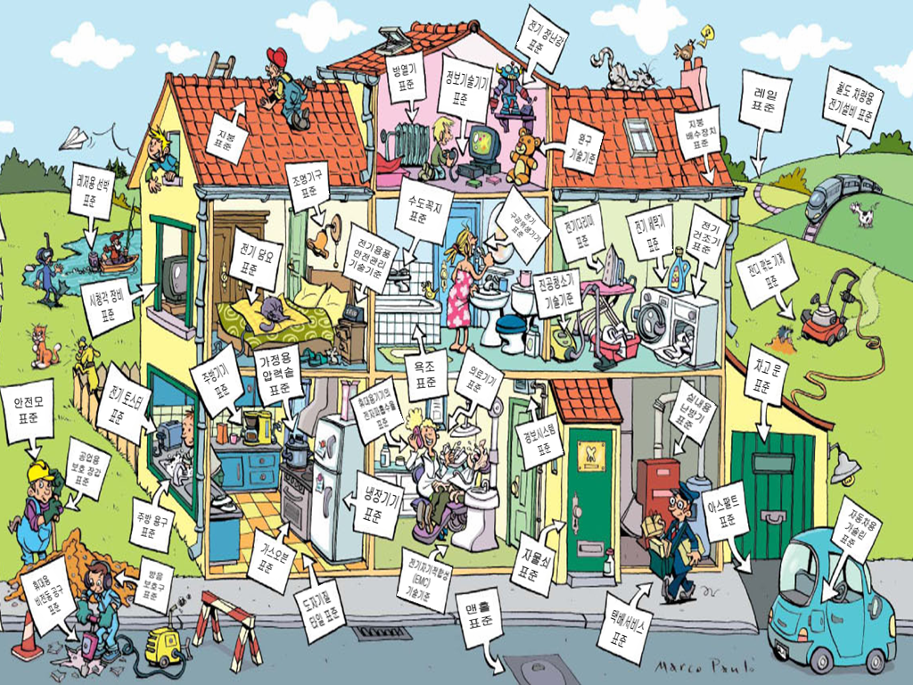
(Korea standard Association, 2008)

Slide 28










1. KCL at a glance
KCL is a leading testing and certification agency in South Korea based on the nation’s top technical skills, infrastructure and research manpower.
230,000
Test Reports
In 2010~2020
OVER
27
ISO Standards
Proposals
OVER
35,000
Customers
24
Global Networks
Countries
196
Revenue
99
National Recognitions
OVER
KRW
billion
943
Employees
500
R&D Projects
ABOUT
OVER
Business Portfolio
Energy
Electricity/
Electronics
Medical/
Bio Products
Mobility
Construction
Parts & Materials
Chemistry/
Environment
Consumer Safety
Fire Safety

Slide 29

2. History
KCL is a leading testing and certification agency in South Korea based on the nation’s top technical skills, infrastructure and research manpower.
Basis of Establishment
Brief History
[Law] Article 32 of the Civil Act 『Incorporation of Non-profit-making Juristic Person and Permission thereof』
[Ministry] Korean Agency for Technology and Standards (KATS) under the Ministry of Trade, Industry and Energy (MOTIE)
1971
[Apr. 10] Establishment of Korea Export Goods Testing Laboratory
1994
[Jul.. 15] Establishment of Korea Institute of Construction Materials
2010
KOLAS training &
sector-based technical training
KS certification &
product evaluation
[Jul. 08] Launch of Korea Conformity Laboratories [KCL]
2014
[May 15] Infrastructure supply for building energy performance
evaluation and consulting service (SASO, Saudi Aribia)
2015
[Apr. 28] Opening of China Branch in Qingdao
[Jul. 01] Launch of incorporated foundation [KCL]
[Oct. 26] Declaration of “KCL Vision 2020”
[Nov. 30] Designation as KS Certification Institution
Trainingㆍ
Consulting
Evaluation
Testing ㆍInspection
2016
[Jun. 28] Opening of Samcheok Real-scale Fire Testing & Research Center
[Nov. 11] Opening of Daegu Safety Convergence Technology Center
2017
[May. 23] Opening of Jincheon Climatic Environment Real-scale Test Center
Certification
R&D
[Oct. 19] Award the presidential citation at the World Standards Day
2018
[Feb. 08] Ground breaking ceremony for Yeosu CO₂ business platform
Construction, energy,
environment, chemistry, medical, etc.
2019
[May. 08] Opening of Daegu & Gyeongbuk Branch new buildings
[Jun. 25] Transfer of Honam Division head office to Yeosu and completion
of Carbon Capture & Utilization(CCU) center
Mandatory & voluntary certification
National standard enactment and revision, new technology & policy development
2020
[Apr. 20] Opening of Jincheon Battery Center
[Sep. 21] Opening of Gyeongnam Branch building in Yeongnam Division

